Slide 1
Finance Sales Dashboard - Analysis
Analyzing Sales, Profit, and Performance Trends
Presented By: Jitu Kumar
Date: 26.11.2024

Slide 2
Table of contents
01
02
03
04
Profitability Analysis
Financial Performance Overview
Examines profit distribution across segments, countries, and products, highlighting high-performing areas.
Provides a snapshot of total sales, profit, and discounts, with a detailed breakdown by product and segment.
Time Based Analysis
Conclusion and Recommendations
Analyzes sales and profit trends over time with insights into year-to-date performance and growth percentages.
Highlights trends and recommends focusing on high-margin products and improving low-profit areas.

Slide 3
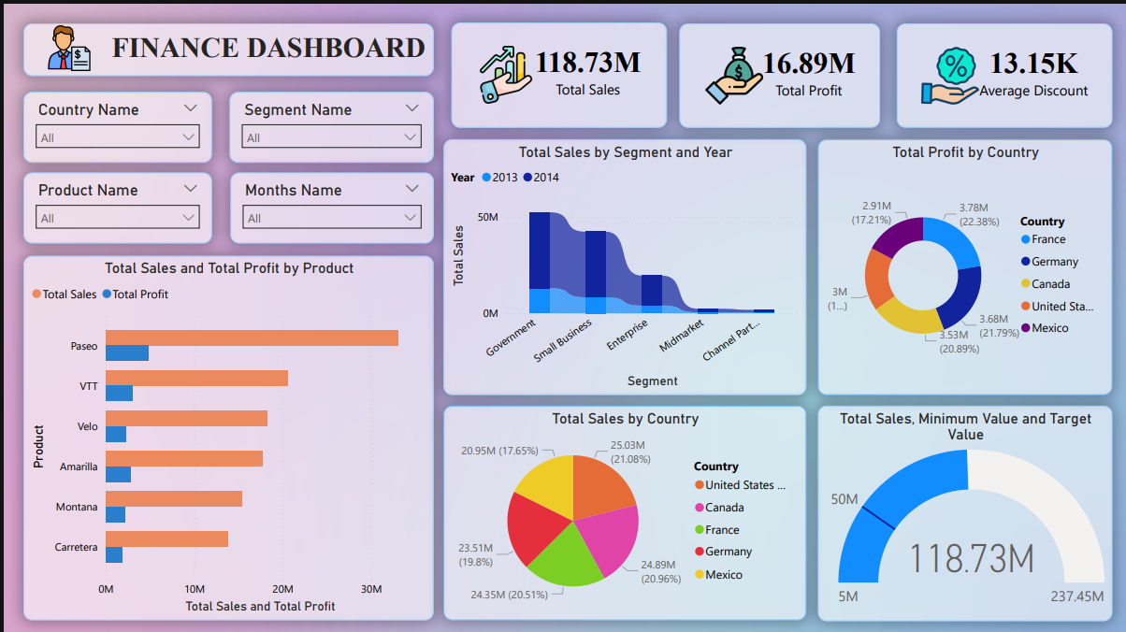
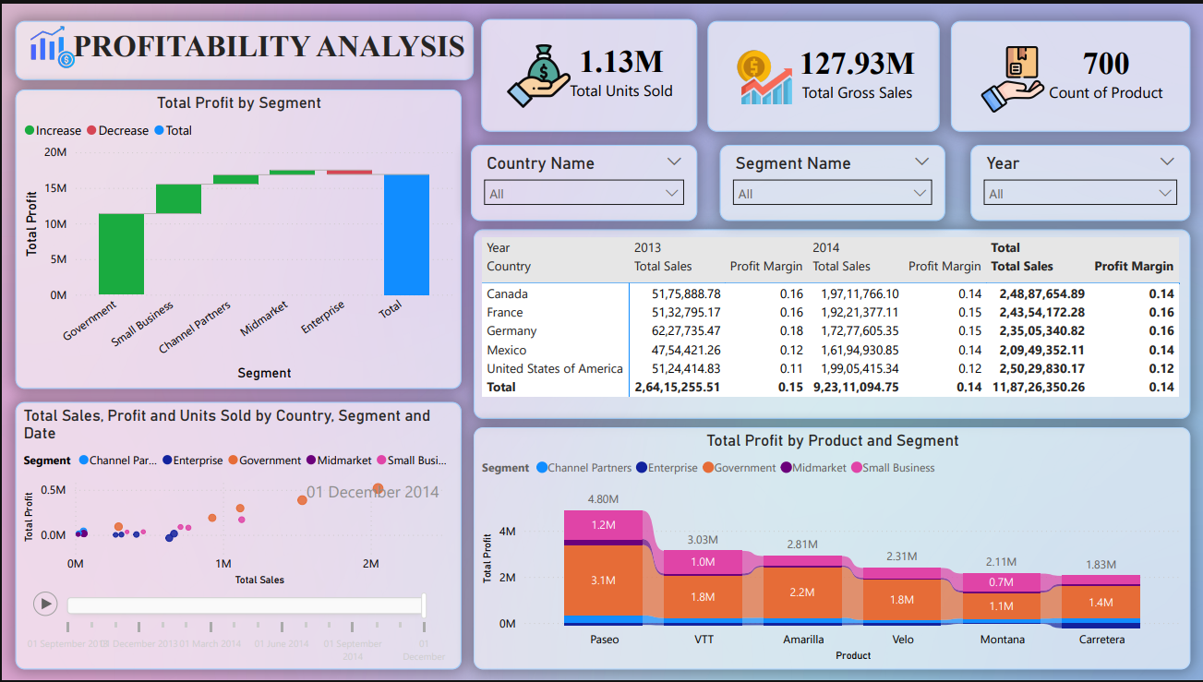
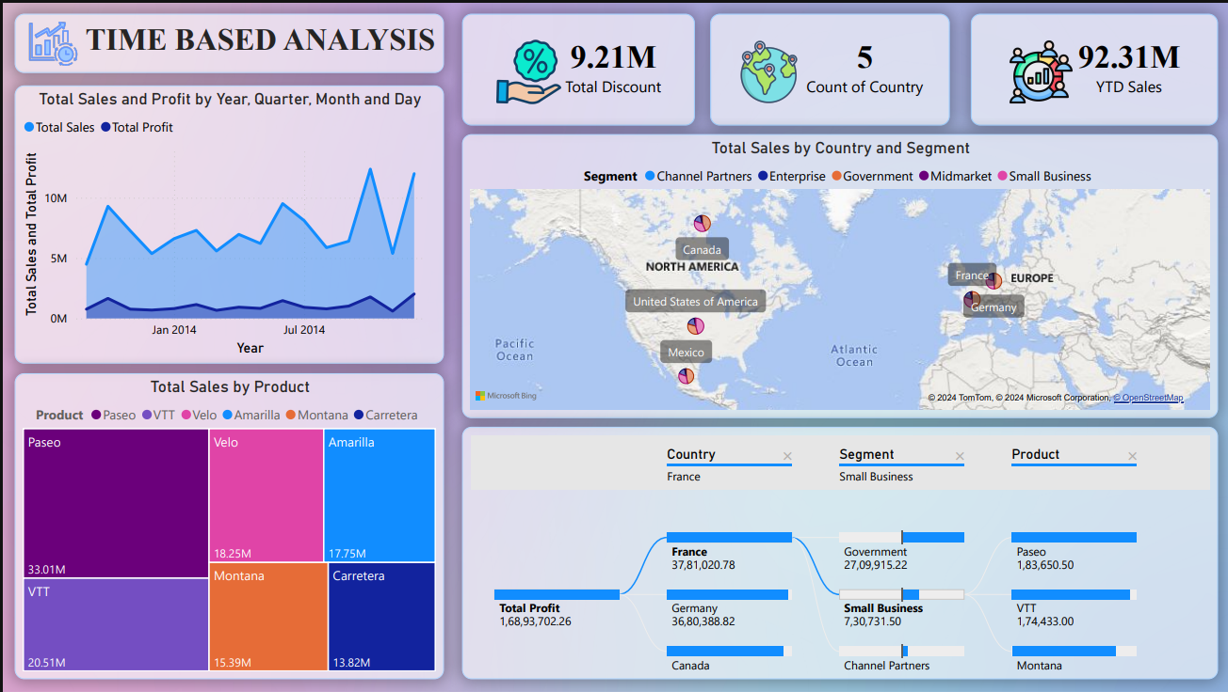
Introduction
This Financial Sales Dashboard provides an interactive platform to analyze sales, profit, and performance trends.
It uses dynamic visuals and DAX calculations to drive data-based decisions for profitability and growth.
Figure 1: Financial Performance Overview
Figure 3: Time-based Analysis
Figure 2: Profitability Analysis

Slide 4
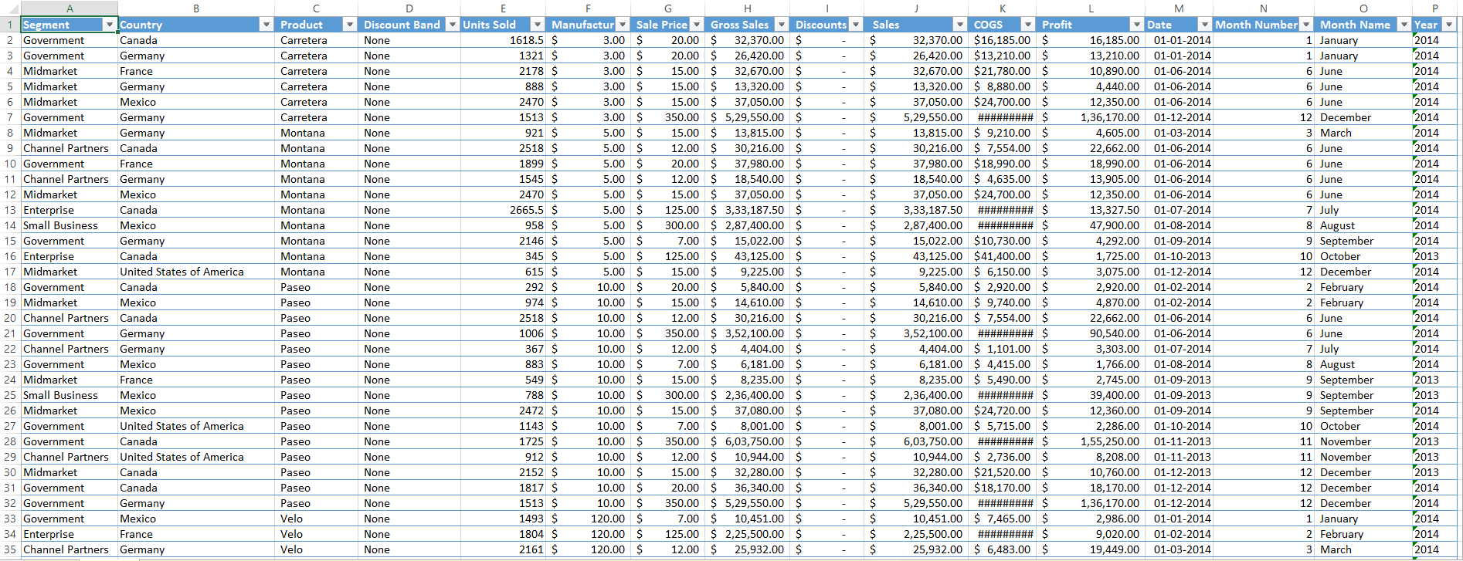
Dataset Overview
Rows and Dimensions:
b. Geographies:
c. Time Frame:
d. Metrics:
700 rows of financial data.
Covers segments, products, geography, time periods, and key metrics.
United States, Canada, Mexico, France, and Germany.
Data spans 2014, broken into years, quarters, months, and days.
Sales, Gross Sales, Discounts, Profit, Units Sold.
Figure : Dataset

Slide 5
Financial Performance Overview
Report : 01
Report 1 focuses on an overview of financial performance, including total sales, profit, and discounts across regions, segments, and products.
The purpose is to provide a clear snapshot of key metrics and identify top contributors to business growth.
Figure : Financial Performance Overview

Slide 6
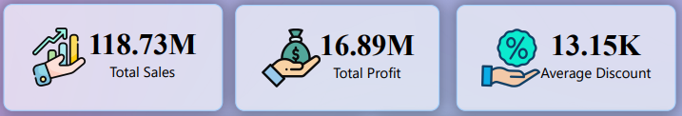
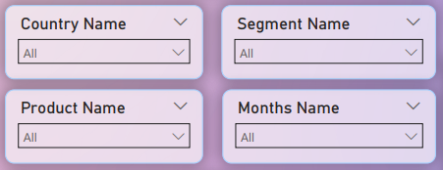
Financial Performance Overview
Report : 01
Total Sales: Sales revenue reached 118.73M.
Total Profit: Profit amounted to 16.89M.
Average Discount: Average discount offered was 13.15K.
Country Name: Filter data by specific countries.
Segment Name: Focus on different business segments.
Product Name: View sales and profit by individual products.
Months Name: Analyze performance by specific months.
Figure 1: Cards Visual
Figure 2: Slicers Visual

Slide 7
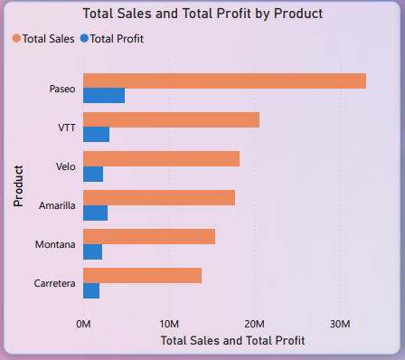
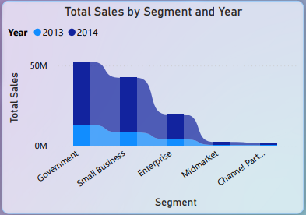
Financial Performance Overview
Report : 01
Displays total sales and total profit for each product, allowing a quick comparison of their performance.
It shows total sales by segment and year, highlighting trends and shifts in performance over time.
Figure 3: Clustered Bar Chart
Figure 4: Ribbon Chart

Slide 8
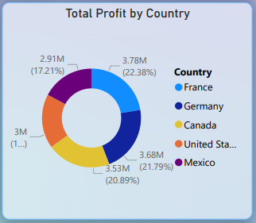
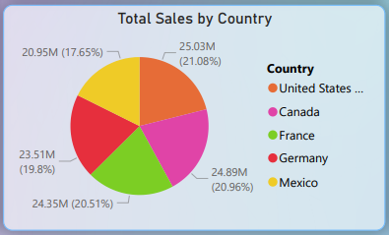
Financial Performance Overview
Report : 01
Represents total profit distribution across countries, providing a clear view of profit contribution by each country.
Illustrates total sales distribution across countries, showing percentage contributions of each region.
Figure 5: Donut Chart
Figure 6: Pie Chart

Slide 9
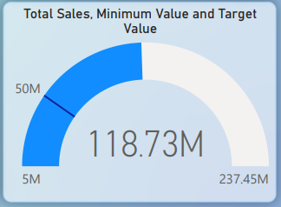
Financial Performance Overview
Report : 01
Displays the total sales value against a target, emphasizing the progress toward achieving sales goals.
Figure 7: Gauge Chart

Slide 10
Report : 01
Final Thoughts For Financial Performance Overview Report
In conclusion, Report 1 provides a comprehensive analysis of total sales, profits, and discount patterns across countries, segments, and products.
This dashboard enables informed decision-making by identifying key contributors to overall performance.
Figure : Financial Performance Overview

Slide 11

Profitability Analysis
Report : 02
The Profitability Analysis Dashboard focuses on evaluating profit margins, total sales, and units sold across different segments, countries, and products.
The purpose of this report is to analyze the contribution of various segments to overall profitability, identify key drivers of profit, and provide insights for optimizing product and segment performance.
Figure : Profitability Analysis

Slide 12
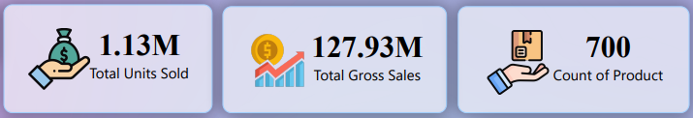

Profitability Analysis
Report : 02
Total Units Sold: 1.13M units sold across all segments.
Total Gross Sales: Total sales amount to 127.93M.
Count of Product: 700 unique products available.
Country Name: Select a country to filter data.
Segment Name: Choose a segment for focused analysis.
Year: Filter data by the selected year.
Figure 1: Cards Visual
Figure 2: Slicers Visual

Slide 13
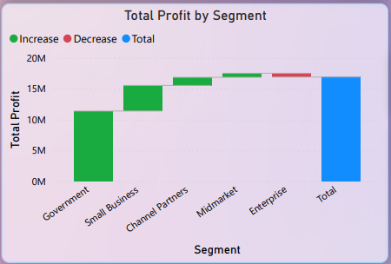
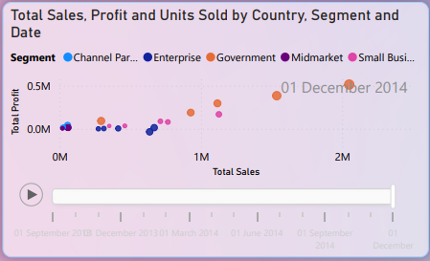
Profitability Analysis
Report : 02
This chart visualizes the total profit by segment, illustrating the contribution of each segment (e.g., Government, Small Business) to the overall profit and highlighting areas of increase and decrease.
This scatter chart shows the relationship between total sales, total profit, and units sold across different segments, helping identify trends and correlations between key metrics.
Figure 3 : Waterfall Chart
Figure 4: Scatter Chart

Slide 14
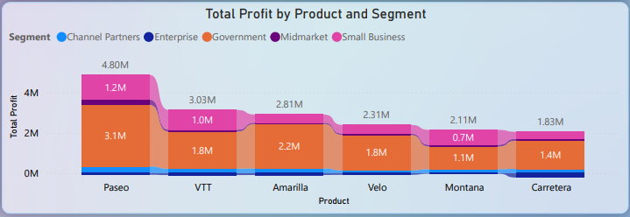
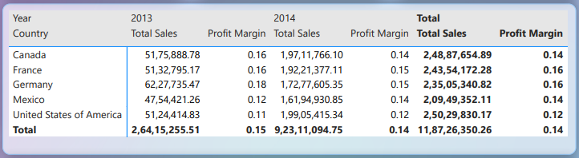
Profitability Analysis
Report : 02
The stacked column chart displays total profit by product and segment, helping to compare the performance of different products (such as VTT, Velo, and Montana) within each segment and identify which products drive the most profit.
The matrix shows total sales and profit margins for each country and year, giving detailed insights into the performance of each region across the years 2013 and 2014.
Figure 5 : Stacked Column Chart
Figure 6: Matrix Visual

Slide 15

Final Thoughts For Profitability Analysis Report
Report : 02
In conclusion, Report 2 shows key insights on sales, profit, and units sold by segment and country, highlighting trends and profitability.
Focus on high-performing segments and countries for better profit margins and monitor profit fluctuations.
Figure : Profitability Anlaysis

Slide 16
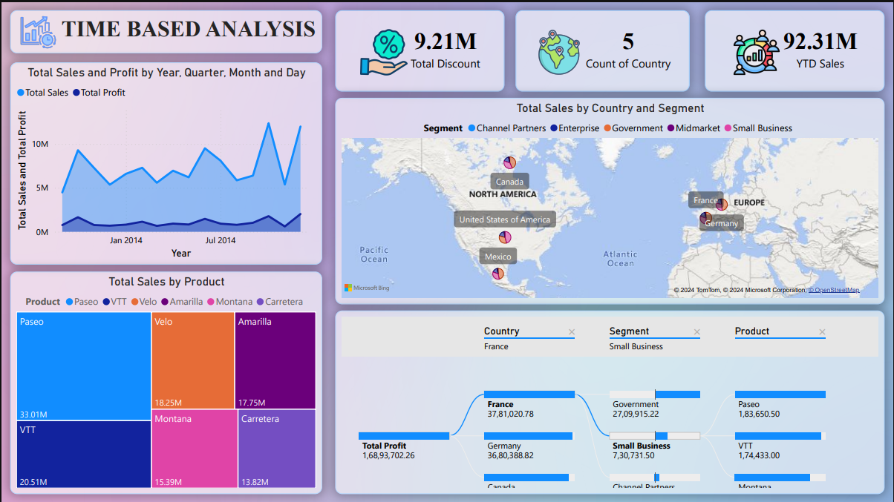
Time Based Analysis
Report : 03
Report 3, focusing on Time-Based Analysis, providing insights into sales and profit trends across time periods, products, and countries.
This report is designed to identify seasonal trends, top-performing products, and country-wise sales patterns to guide strategic decisions."
Figure : Time Based Analysis

Slide 17
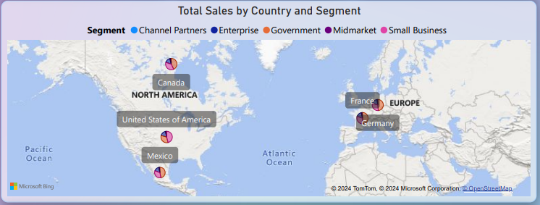
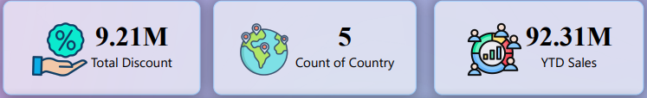
Time Based Analysis
Report : 03
A total discount of 9.21M was offered across 5 countries, achieving 92.31M in YTD sales.
The map visual illustrates total sales distribution by country and segment, emphasizing strong performances in Canada, France, and Germany. This geographic insight highlights regions of success and potential markets for expansion.
Figure 1 : Cards Visual
Figure 2: Map

Slide 18
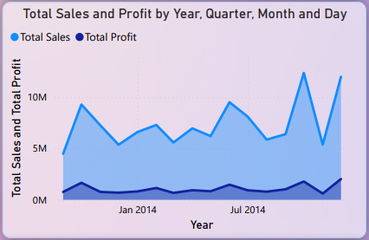
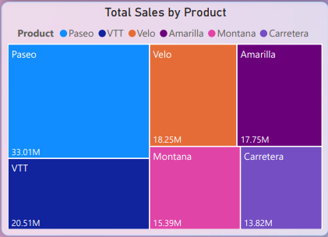
Time Based Analysis
Report : 03
The line chart highlights sales and profit trends show significant peaks in 2014, indicating strong seasonal or campaign performance
Products like 'Paseo' (33.01M) and 'Velo' dominate sales, highlighting top-performing categories.
Figure 3 : Line Chart
Figure 4: Treemap

Slide 19
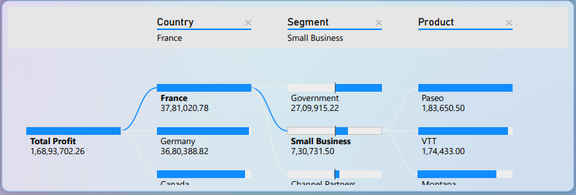
Time Based Analysis
Report : 03
France leads profitability (37.81M), with small businesses contributing consistently to total profits.
Figure 5 : Decomposition Tree

Slide 20
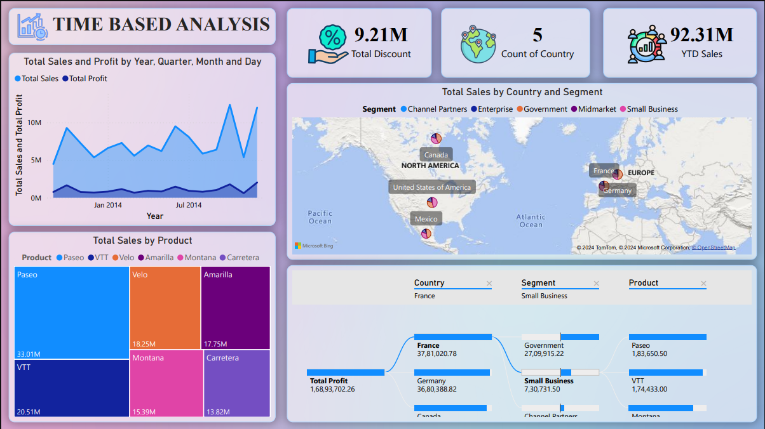
Final Thoughts For Time Based Analysis Report
Report : 03
In summary, this analysis highlights the time-based sales and profit performance, with notable trends showing 2014 as a peak year.
Products like 'Paseo' and 'Velo' led sales, while key markets such as France, Germany, and Canada drove profitability.
Discounts played a significant role in maintaining competitive sales across 5 countries.
Figure : Time Based Analysis

Slide 21
Overall Conclusion
From Report 1, we observed how profitability varies across business segments, with 'Small Business' and 'Government' being significant contributors.
In Report 2, we analyzed profitability further by understanding the influence of key metrics like total profit, product performance, and market segmentation.
Report 3 provided time-based insights, identifying seasonal trends and the performance of products and countries over time, with a focus on the impact of discounts.
Recommendations
Focus on Small Business and Government segments for higher profitability.
Prioritize products like Paseo and VTT while improving weaker products.
Tailor marketing strategies for strong regions like France and Germany.
Align promotions with seasonal trends for maximum sales impact.

Slide 22
THANKS

